Slide 1
ACT Reading Strategies

Slide 2

On the Testing Days…
• breathe ☺
• do exactly what directions ask
R
A
F
T
elax
• stay positive
• remember: this is for you!
ttitude
• be like a shark -- keep moving
• answer every question
ocus
• seek best answers
• do what your brain does best!
hink!

Slide 3
Now, let’s focus on the
ACT Reading Test…
• Read 4 Passages
• Answer 40 Multiple Choice Questions
• In 35 Minutes (≈ 8 1/2 min. / passage)
The ACT Reading Test assesses a student’s ability to
• read and understand the lines
• read and understand between the lines.

Slide 4
***Each reading passages represents
a different type of text:
Fiction (a novel or short story excerpt)
II. Social Science (an informative piece from anthropology, business, economics, history, political science, psychology, sociology, etc.)
Humanities (a “personal” or informative piece from
  the arts, literature,music, philosophy, etc.)
IV. Natural Science (an informative piece from biology, chemistry, geology, medicine, physics, technology, zoology, etc.)

Slide 5
***ACT Reading Test Questions
Ask Students To…
• determine main ideas
• locate & interpret important details
• understand sequences of events
• make comparisons
• determine cause/effect relationships
• make generalizations / conclusions
• analyze the passage's mood or tone
Pay attention to
• names, dates, titles, theories
• italicized terms

Slide 6
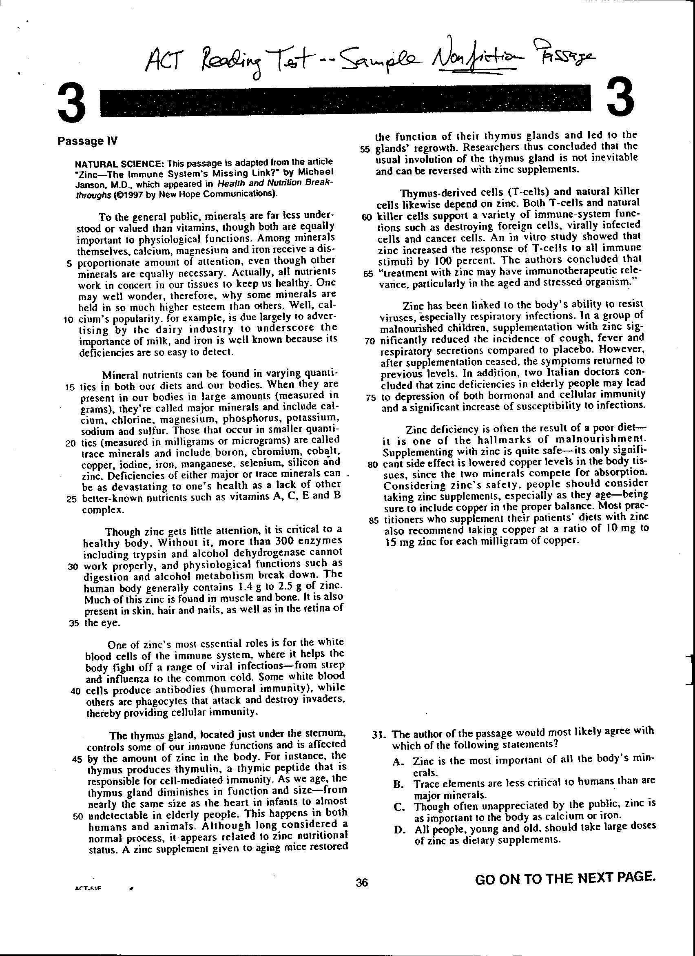
***A Nonfiction Strategy:
4.
Read 1st sentence of other ¶s. Mark key words. Skim rest of ¶, looking for impt. info.
1.
Underline
title & author
for clues to
topic.
2.
Closely read 1st ¶ for author’s
thesis.
What does s/he want you to know, think, or believe?
3.
Closely read last ¶ to verify
thesis.
Reader should now know author’s main point.

Slide 7
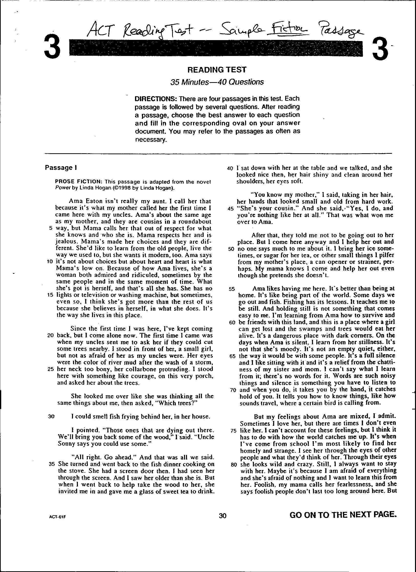
***A Fiction Strategy:
1.
Read the 1st column to identify
• setting
• characters
• the problem
2.
Read the 2nd column to identify
• attempted
solutions
*** don’t expect a full solution
Read with a pencil in hand!

Slide 8
***Regardless of the reading passage…
• Mark the text / underline / annotate.
• Expect the text to be uninteresting --
make yourself think & read!
(After all, it’s only 35 min.)
• When answering questions, only go back
and reread the passage when a line
number appears in the item.
• Trust your impressions of the text.
• Pace yourself -- work smarter.

Slide 9
ACT Reading Test
Remember the Format:
• Read 4 Passages
• Answer 40 Multiple Choice Questions
• In 35 Minutes (≈ 8 1/2 min. / passage)

Slide 10
***Each reading passages represents
a different type of text:
Fiction (a novel or short story excerpt)
II. Social Science (an informative piece from anthropology, business, economics, history, political science, psychology, sociology, etc.)
Humanities (a “personal” or informative piece from
  the arts, literature,music, philosophy, etc.)
IV. Natural Science (an informative piece from biology, chemistry, geology, medicine, physics, technology, zoology, etc.)

Slide 11
***A Nonfiction Strategy:
4.
Read 1st sentence of other ¶s. Mark key words. Skim rest of ¶, looking for impt. info.
1.
Underline
title & author
for clues to
topic.
2.
Closely read 1st ¶ for author’s
thesis.
What does s/he want you to know, think, or believe?
3.
Closely read last ¶ to verify
thesis.
Reader should now know author’s main point.

